Slide 1
NAAN MUDHALVAN
EMAIL PHISHING
Raja Pandi .S
Aalim muhammed salegh college of engineering
CSE

Slide 2
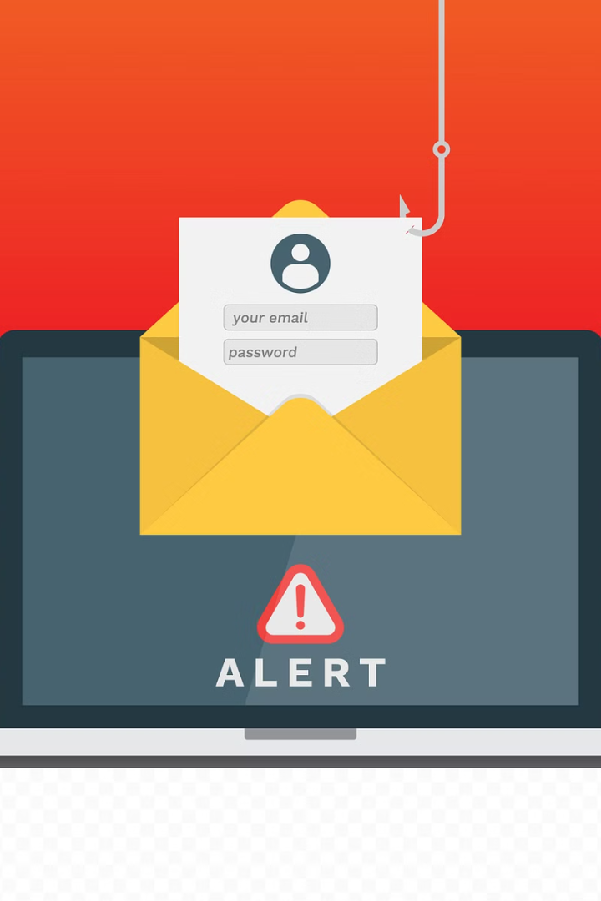
Introduction
Email phishing is a prevalent cyber threat that targets individuals and organizations. It involves deceptive tactics to trick recipients into disclosing sensitive information or taking harmful actions. This presentation aims to raise awareness and provide essential guidance to combat email phishing attacks.

Slide 3
What is email phishing?
Social Engineering
Fake Identities
Email phishing is a form of social engineering attack that tricks individuals into revealing sensitive information.
Attackers often pose as legitimate organizations or individuals to deceive recipients into taking action.
Deceptive Links
Email Spoofing
Phishing emails contain links that lead to fake websites designed to steal login credentials and personal data.
Phishers may spoof email addresses to appear as reputable sources, adding credibility to their fraudulent messages.

Slide 4
Problem Statement
Targeted Attacks: Phishing emails are becoming increasingly sophisticated, often luring unsuspecting individuals into divulging sensitive information.
Financial Loss: Phishing scams can lead to substantial financial losses for individuals and organizations alike.
Identity Theft: The risk of identity theft through email phishing poses a significant concern for both individuals and businesses.

Slide 5
Proposed Solution
1
Training and Awareness
Implementing regular training programs to educate employees about identifying and reporting phishing attempts.
2
Enhanced Email Security
Deploying advanced email filtering and scanning technology to detect and block phishing emails before they reach the inbox.
3
Multi-Factor Authentication
Enforcing multi-factor authentication to add an extra layer of security for access to sensitive systems and data.

Slide 6

System Approach
The system approach to email phishing involves a comprehensive strategy that integrates security protocols, encryption measures, and user education.
It focuses on identifying potential vulnerabilities in the email system, implementing robust firewalls, and continuous monitoring for suspicious activities.

Slide 7
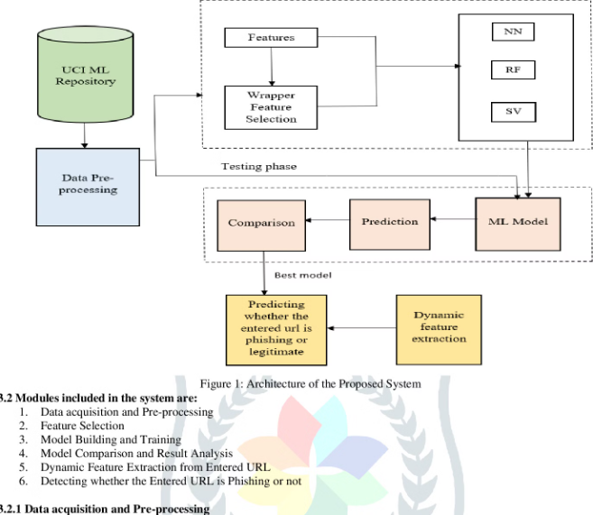
Algorithms and Deployment
Implementing effective phishing detection algorithms is crucial in safeguarding against cyber threats. Machine learning models and behavioral analytics are commonly used to identify suspicious email patterns and content.
Deployment strategies involve integrating these algorithms into email servers and clients, ensuring real-time protection against evolving phishing techniques.

Slide 8




Who are the End Users?
Employees
Individual Users
Security Teams
Customers
Staff members who use email for work communication.
People who use email for personal and professional purposes.
Professionals responsible for safeguarding against phishing attacks.
Individuals who may be targeted as part of phishing scams.

Slide 9

Agenda
In today's agenda, we will cover the current state of email phishing, the proposed solutions, and the system approach to combat this threat effectively. Additionally, we will delve into the algorithms and deployment strategies. We'll also discuss the target end users, future scope, and conclude with key takeaways.

Slide 10



Future Scope
Enhanced Security Measures
1
Implementing advanced encryption techniques
AI-powered Detection
2
Integrating machine learning for real-time threat analysis
User Awareness Programs
3
Developing educational campaigns to promote email security
Looking ahead, the future of email phishing prevention involves implementing enhanced security measures such as advanced encryption techniques, integrating AI-powered detection through machine learning for real-time threat analysis, and developing user awareness programs through educational campaigns to promote email security among individuals and organizations.

Slide 11
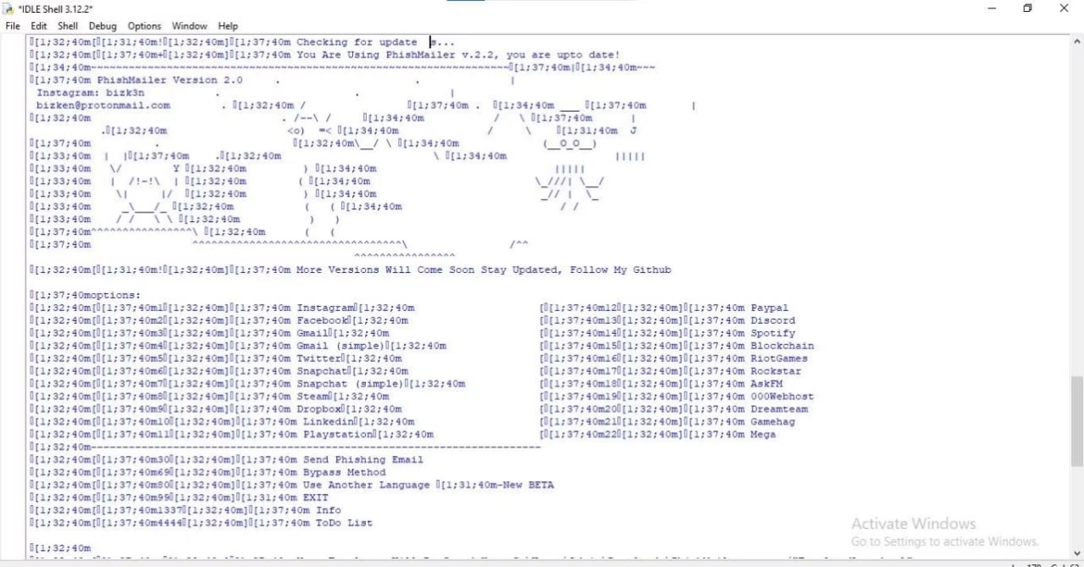
Output

Slide 12
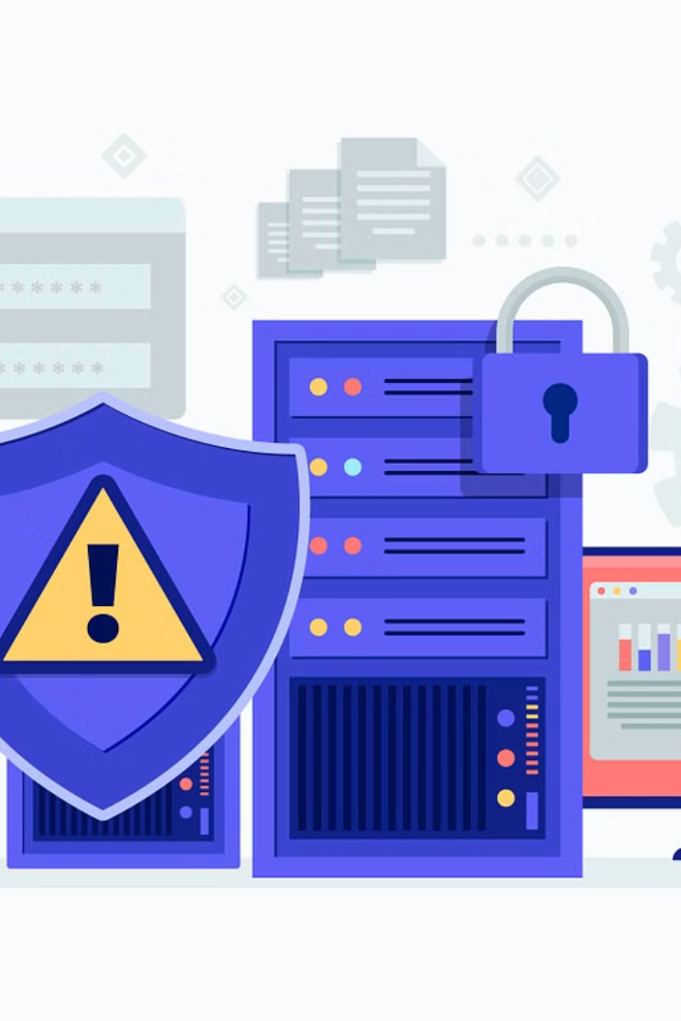
Conclusion
In conclusion, email phishing remains a significant threat to data security and privacy. It is imperative for individuals and organizations to stay vigilant and implement robust security measures to combat this pervasive issue. As technology continues to evolve, the fight against email phishing will require ongoing innovation and collaboration.

